Slide 1
CAPSTONE PROJECT Rainfall Prediction using EDA and classification models
Submitted by : Palwinder Kaur
ID : 0774105
Submitted to : Prof. Savita Seharawat

Slide 2
ABSTRACT
My dataset is about rain in Australia, and it contains around ten years' worth of daily meteorological observations (from 2007 to 2017) from a variety of sites across the country. There are 145460 records in this collection, with 23 attributes. With 70% of the continent labelled as desert or semi-desert, Australia is the driest populated continent on the planet. On this island continent, rain is the only source of water during that period. Rainfall changes influence water availability in Australia, just as they do in any other region. Dryness (lack of rainfall), floods (excessive rainfall), and droughts are all common weather phenomena on the continent. The eastern Australian provinces were heavily inundated from 2009 to 2012. The northern tropical areas of the country get the greatest rain, while the interior is parched and barren. Water availability, management, and future resource planning are all affected by variations in rainfall. Australia is experiencing a severe drought, which may be helped if rainfall forecasts were used.

Slide 3




RESEARCH QUESTIONS
Find out the degree of temperature that lies as highly concentration points.
Check yearly distribution of rainfall to find the years with minimum and maximum rain fall.
Check the distribution of target attribute.
Build different classification models and select an optimal model by comparing accuracies of all models.

Slide 4
METHODOLOGY
Initial Preprocessing
1
Visualization of Numerical Attributes
2
Experimental Implementation
3
Experimental Evaluation
4
Conclusion
5

Slide 5

DATA PREPROCESSING
Detailed Data Dictionary
Missing values
Data Types Conversion

Slide 6

DATA PREPROCESSING
 | Number of Missing Values
Sunshine | 69835
Evaporation | 62790
Cloud3pm | 59358
Cloud9am | 55888
Pressure9am | 15065
Pressure3pm | 15028
WindDir9am | 10566
WindGustDir | 10326
WindGustSpeed | 10263
Humidity3pm | 4507
WindDir3pm | 4228
Temp3pm | 3609
RainTomorrow | 3267
Rainfall | 3261
RainToday | 3261
WindSpeed3pm | 3062
Humidity9am | 2654
Temp9am | 1767
WindSpeed9am | 1767
MiniTemp | 1485
MaxiTemp | 1261
Detailed Data Dictionary
Missing values
Data Types Conversion
In data dictionary, I checked the datatype, and levels of each attribute and check counts corresponding to them.
Then, I find out that is my dataset contains any null value and from given table we can see that which attribute contain how many missing values.
After that, conversion of datatypes comes where I convert object into category and Date/Time and float into integer.

Slide 7

EXPLORATORY DATA ANALYSIS

Slide 8
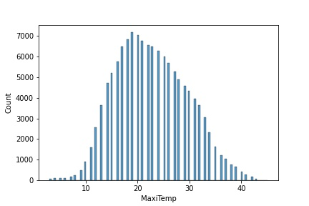
Distribution of Temperature to check Highest Concentration Points
The histogram depicts a normal distribution of maximum temperature that is right skewed because majority of data entries spread towards right and peak to the left. Between 17 to 20 degrees Celsius, the maximum concentration of temperature points can be found.

Slide 9
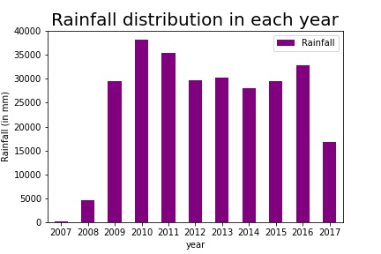
YEARS WITH MAXIMUM AND MINIMUM RAINFALL
The graph above depicts the annual rainfall distribution, as well as the year with the most and east rain during the whole time. We can observe that the wettest years were 2010, 2011, and 2016, with about 33000mm of rain. The wettest years were 2007, 2008, and 2017and average rainfall ranging from 25000 to 30000 mm was experienced in 2009,2012, 2013, 2014, and 2015.

Slide 10
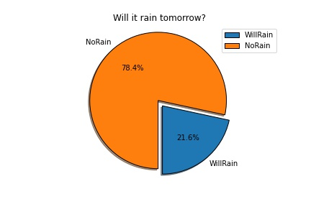
DISTRIBUTION OF TARGET ATTRIBUTE
The Rain Tomorrow attribute's distribution provides information on whether or not it will rain tomorrow, with two options: 'Yes' (Will Rain) and 'No' (Won't Rain) (No Rain). So, after visualizing, I discovered that 'No' held more than half of the data frequencies, while 'Yes' held only a small percentage of the data enteries, indicating that my objective variable is not evenly distributed.

Slide 11
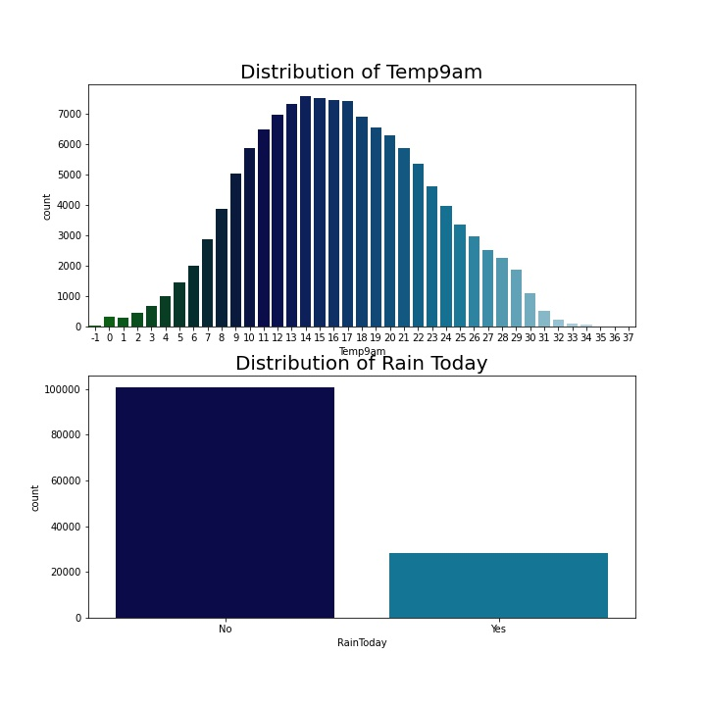
Distribution of Temperature at 9am and Rain Today
The histogram in figure depicts the temperature distribution at 9 a.m., which is normal because it exhibits a single greatest point, indicating that the highest temperature over the entire period was 14 degrees Celsius, with over 7000 counts. Temperatures between -1 and 6 degrees Celsius, as well as 29 and 34 degrees Celsius, were shown to have the lowest values. The bar graph displays whether it will rain today or not, and it is evident that there are no chances of rain today because the proportion is quite low when compared to not having rain.

Slide 12
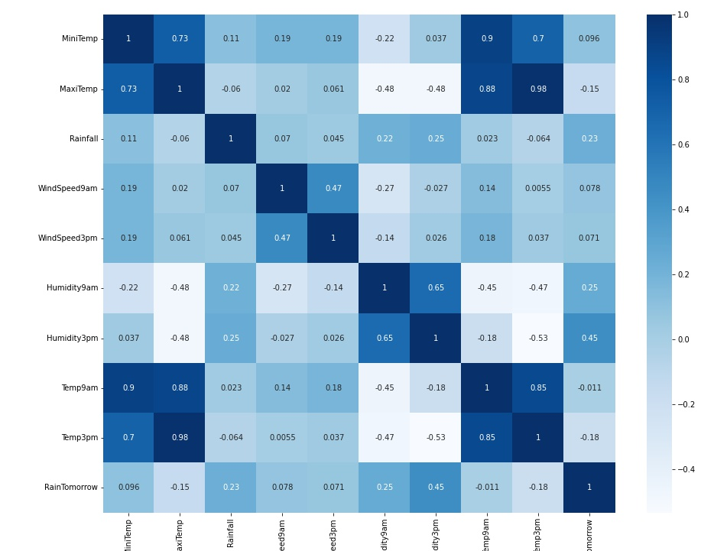
CORRELATION
Correlation shows the relation between two variables and describes the degree in which they move in co-ordination with each other. From graph, we can clearly evaluate that ‘Temp9am’, ‘Temp3pm’ and ‘Maxi Temp’ are strongly co-related.

Slide 13
CORRELATION BETWEEN TARGET VARIABLE AND OTHER ATTRIBUTES
Attributes Names | Column 1
RainTomorrow | 1
Humidity3pm | 0.45
Humidity9am | 0.26
Rainfall | 0.23
Temp3pm | 0.19
MaxiTemp | 0.15
MiniTemp | 0.10
WindSpeed9am | 0.08
WindSpeed3pm | 0.08
Temp9am | 0.02
From Table, it is clearly observable that ‘Humidity3pm’ is most closely associated with Target (Rain Tomorrow) attribute.

Slide 14

EXPERIMENTAL DESIGN

Slide 15
TRAIN TEST SPLIT
To avoid overfitting and appropriately evaluate our models, the data set is divided into two portions in this step: training and testing. When machine learning algorithms are used to make predictions on any data, the train-test split procedure is used to estimate their performance. This method is a quick and simple procedure that allows us to compare the results of our own machine learning model.

Slide 16
DATA NORMALIZATION
The rescaling or re-distribution of numerical data is referred to as data normalization. Data normalization is employed when our real data is not normalized, and it allows us to reorganize data between the 0 and 1 range.
STANDARD SCALER
To normalize my data, I choose the Standard Scaler method, which removes the mean from each number and divides it by the standard deviation.

Slide 17
SAMPLING
It is a technique used to resample or re-distribution of data which is not distributed equally. After checking class distribution of my target variable, I get to know that it is not balanced. So, I need to resample it.
To balance target variable, I used Synthetic Minority Oversampling Technique (SMOTE). It deals with minority class and derived new values to balance both classes.

Slide 18
CLASSIFICATION MODELS
For accuracies, I used four different classification models: logistic regression, K-Nearest Neighbors, Nave Bayes, and Random Forest Classifier. Because our objective variable has two possible outcomes that is why, I use logistic regression classifier (logical outcomes: yes and no). The dependent variable is modelled using it. When our dataset has multiclass classification, which means it has numerous classes, KNN is the best match. The Nave Bayes classifier works with any type of data and is simple to use and understand. With complicated and large amounts of data, Random Forest classifiers perform better.

Slide 19

CROSS VALIDATION
It's a method of determining the efficacy of a machine learning algorithm. Cross-validation is a statistical method for evaluating and comparing learning algorithms in which data is split into two sections: one for learning or training and the other for validating the model.

Slide 20
METHODS
K-folds Cross Validation
Cross-validation is a resampling technique for evaluating machine learning models on a small sample of data. It's a non-replacement resampling technique. K-fold cross-validation is a method for estimating a model's performance on unknown data.
K-folds Cross Validation
Stratified K-fold
Repeated Random Test-Train Splits

Slide 21
Stratified K-fold
This cross-validation object returns stratified folds and is a variant of K-Fold. The folds are created by keeping track of the percentage of samples in each class. The stratified k fold cross-validation technique is a variant of the cross-validation technique for classification issues. Throughout the K folds, it retains the same class ratio as the original dataset.
Repeated Random Test-Train Splits
I make random splits of the data in the training-test set and then repeat the process of splitting and evaluating the algorithm five times in this technique. With this strategy, I combine the k-fold cross validation method with traditional train-test splits and test the algorithm again and again.

Slide 22
ACCURACY MATRIX
levels | Model | train_test_split | kfolds_5 | Stratifiedkfold_5 | RRTestTrainSplits_5
0 | Logistic Regression | 74.25 | 80.18 | 84.03 | 83.01
1 | KNN | 71.63 | 66.73 | 73.98 | 74.01
2 | Naive Bayes | 77.49 | 68.54 | 72.32 | 72.14
3 | Random Forest | 74.19 | 90.12 | 89.74 | 89.99

Slide 23
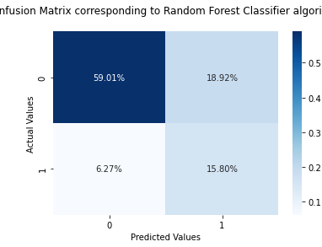
CONFUSION MATRIX CORRESPONDING TO AN OPTIMAL MODEL [RFC]
A confusion matrix is a table structure that allows you to see how well an algorithm performs. A confusion matrix will show us the classification model's performance as well as the types of errors it produces. In a number count, a confusion matrix outputs both right and wrong values. An error matrix is a tool for evaluating and forecasting the correctness of a classification model. It shows the True Negative value with 15.80% whereas, True Positive value is 59.01%. Moreover, False Positive value scores 6.27% and False Negative value is 18.92%.

Slide 24
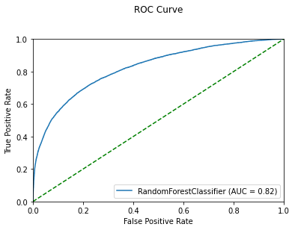
ROC [Receiver Operating Characteristics] CURVE
ROC curve is a graphical representation of classification models which helps in measuring their performance accuracy. It includes an Area Under Curve [AUC] score which demonstrates that how well our model can differentiate between classes. This ROC curve depicts that AUC score is 0.82 which indicates that this is an optimal classifier.

Slide 25
CLASSIFICATION REPORT
Column1 | Precision | Recall | f1-score | support
0 | 0.91 | 0.74 | 0.82 | 30247
1 | 0.45 | 0.73 | 0.56 | 8566
accuracy |  |  | 0.74 | 38813
macro avg | 0.68 | 0.74 | 0.69 | 38813
Weighted avg | 0.81 | 0.74 | 0.76 | 38813

Slide 26
CONCLUSION
Following the development and evaluation of classification models, we discovered that the 'Random Forest Classifier' is the best model for our dataset because it has the maximum accuracy. My goal was to anticipate an optimal model for my dataset. By looking at the distribution of the Target variable, we can see that there are very few chances of rain tomorrow because it makes up a small fraction of the total data. We also use K-fold, Stratified k-fold, and Repeated Random Train-tests to perform cross validation and determine that the RFC model has the maximum accuracy in each approach. The AUC value on the ROC curve is 0.82, indicating that Random Forest is a perfect model.

Slide 27


